Slide 1
CSE 411
Software Testing and Quality Assurance
Model-Driven Test Design
Lecture 2
Md. Rafsan Jani

Slide 2
Complexity of Testing Software
No other engineering field builds products as complicated as software
The term correctness has no meaning
Is a building correct?
Is a car correct?
Is a subway system correct?
Instead of looking for “correctness,” wise software engineers try to evaluate software’s “behavior” to decide if the behavior is acceptable within consideration of a large number of factors including (but not limited to) reliability, safety, maintainability, security, and efficiency.
Obviously this is more complex than the naive desire to show the software is correct.

Slide 3
Complexity of Testing Software
Like other engineers, we must use abstraction to manage complexity
This is the purpose of the model-driven test design process
The “model” is an abstract structure
The Model-Driven Test Design (MDTD) process breaks testing into a series of small tasks that simplify test generation.
Then test designers isolate their task, and work at a higher level of abstraction by using mathematical engineering structures to design test values independently of the details of software or design artifacts, test automation, and test execution.

Slide 4
Software Testing Foundations (2.1)
Testing can only show the presence of failures
Not their absence

Slide 5
Fault & Failure Model (RIPR)
Four conditions necessary for a failure to be observed
Reachability : The location or locations in the program that contain the fault must be reached
Infection : The state of the program must be incorrect
Propagation : The infected state must cause some incorrect output or final state
Reveal : The tester must observe part of the incorrect portion of the program state

Slide 6
RIPR Model
Reachability
Infection
Propagation
Revealability
Test
Final Program State
Observed Final Program State
Reaches
Incorrect Final State
Fault
Infects
Propagates
Incorrect Program State
Reveals
Test Oracles
Notes:
The failures can be revealed when the observed final program state has overlap with the incorrect final program state.
The question is: should testers check the entire program state? How to observe the incorrect program state in a cost-effective manner.
Getting the overlap as big as possible and use the cost as small as possible.

Slide 7
Software Testing Activities (2.2)
Test Engineer : An IT professional who is in charge of one or more technical test activities
Designing test inputs
Producing test values
Running test scripts
Analyzing results
Reporting results to developers and managers
Test Manager : In charge of one or more test engineers
Sets test policies and processes
Interacts with other managers on the project
Otherwise supports the engineers

Slide 8
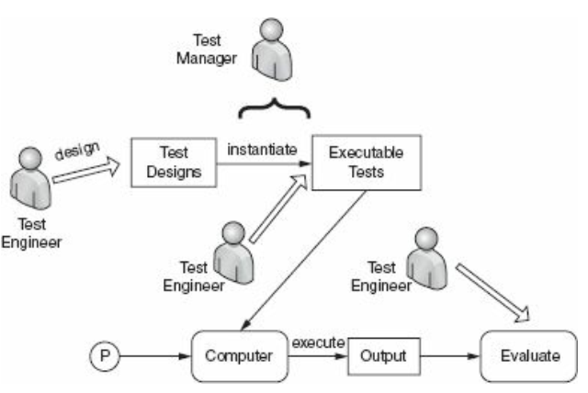
Figure: Activities of test engineer and manager.

Slide 9
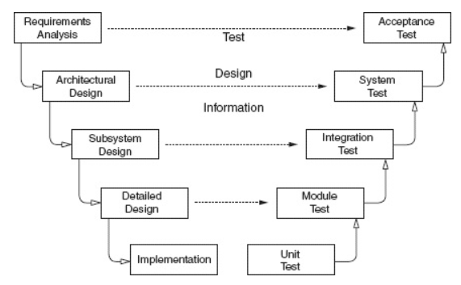
Traditional Testing Levels
Figure: Software development activities and testing levels – the “V Model”

Slide 10
V-Model
The requirements analysis phase of software development captures the customer’s needs.
Acceptance testing is designed to determine whether the completed software in fact meets these needs. In other words, acceptance testing probes whether the software does what the users want.
Acceptance testing must involve users or other individuals who have strong domain knowledge.

Slide 11
V-Model Cont.
The architectural design phase of software development chooses components and connectors that together realize a system whose specification is intended to meet the previously identified requirements.
System testing is designed to determine whether the assembled system meets its specifications. It assumes that the pieces work individually, and asks if the system works as a whole.
This level of testing usually looks for design and specification problems.
It is a very expensive place to find lower-level faults and is usually not done by the programmers, but by a separate testing team

Slide 12
V-Model Cont.
The subsystem design phase of software development specifies the structure and behavior of subsystems, each of which is intended to satisfy some function in the overall architecture. Often, the subsystems are adaptations of previously developed software.
Integration testing is designed to assess whether the interfaces between modules (defined below) in a subsystem have consistent assumptions and communicate correctly.
Integration testing must assume that modules work correctly.
Integration testing is usually the responsibility of members of the development team

Slide 13
V-Model Cont.
The detailed design phase of software development determines the structure and behavior of individual modules. A module is a collection of related units that are assembled in a file, package, or class.
This corresponds to a file in C, a package in Ada, and a class in C++ and Java.
Module testing is designed to assess individual modules in isolation, including how the component units interact with each other and their associated data structures.
Most software development organizations make module testing the responsibility of the programmer; hence the common term developer testing.

Slide 14
V-Model Cont.
Implementation is the phase of software development that actually produces code. A program unit, or procedure, is one or more contiguous program statements, with a name that other parts of the software use to call it.
Units are called functions in C and C++, procedures or functions in Ada, methods in Java, and subroutines in Fortran.
Unit testing is designed to assess the units produced by the implementation phase and is the “lowest” level of testing.
As with module testing, most software development organizations make unit testing the responsibility of the programmer, again, often called developer testing.

Slide 15
Traditional Testing Levels
Acceptance testing : Is the software acceptable to the user?
main Class P
System testing : Test the overall functionality of the system
Class A
Class B
Integration testing : Test how modules interact with each other
method mA1()
method mB1()
method mA2()
method mB2()
Module testing (developer testing) : Test each class, file, module, component
Unit testing (developer testing) : Test each unit (method) individually
This view obscures underlying similarities

Slide 16
Object-Oriented Testing Levels
Inter-class testing : Test multiple classes together
Class A
Class B
Intra-class testing : Test an entire class as sequences of calls
method mA1()
method mB1()
method mA2()
method mB2()
Inter-method testing : Test pairs of methods in the same class
Intra-method testing : Test each method individually

Slide 17
Coverage Criteria (2.4)
Even small programs have too many inputs to fully test them all
double computeAverage (int A, int B, int C)
On a 32-bit machine, each variable has over 4 billion possible values
Over 80 octillion possible tests!!
Input space might as well be infinite
This is the source of two key problems in testing:
(1) how do we search? and
(2) when do we stop?
Testers search a huge input space
Trying to find the fewest inputs that will find the most problems

Slide 18
Coverage Criteria (2.4)
Coverage criteria give structured, practical ways to search the input space
Satisfying a coverage criterion gives a tester some amount of confidence in two crucial goals:
Search the input space thoroughly
Not much overlap in the tests
Coverage criteria have many advantages for improving the quality and reducing the cost of test data generation.

Slide 19
Advantages of Coverage Criteria
Maximize the “bang for the buck”, with fewer tests that are effective at finding more faults
Provide traceability from software artifacts to tests
Source, requirements, design models, …
Make regression testing easier
Gives testers a “stopping rule” … when testing is finished
Can be well supported with powerful tools

Slide 20
Test Requirements and Criteria
Test Criterion : A collection of rules and a process that define test requirements
Cover every statement
Cover every functional requirement
Test Requirements : Specific things that must be satisfied or covered during testing
Each statement might be a test requirement
Each functional requirement might be a test requirement
Testing researchers have defined dozens of criteria, but they are all really just a few criteria on four types of structures …
Input domains
Graphs
Logic expressions
Syntax descriptions

Slide 21
Old View : Colored Boxes
Black-box testing(BBT) : Derive tests from external descriptions of the software, including specifications, requirements, and design
White-box testing(WBT) : Derive tests from the source code internals of the software, specifically including branches, individual conditions, and statements
Model-based testing(MBT) : Derive tests from a model of the software (such as a UML diagram)
MDTD makes these distinctions less important.
The more general question is:
from what abstraction level do we derive tests?

Slide 22
White-box vs Black-box Testing
White-box testing a.k.a. structural testing
Examines source code with focus on:
Control flow
Data flow
Control flow refers to flow of control from one instruction to another. Data flow refers to propagation of values from one variable or constant to another variable
It is applied to individual units of a program
Software developers perform structural testing on the individual program units they write
Black-box testing a.k.a. functional testing
Examines the program that is accessible from outside
Applies the input to a program and observe the externally visible outcome
It is applied to both an entire program as well as to individual program units
It is performed at the external interface level of a system. It is conducted by a separate software quality assurance group

Slide 23
Types of Test Activities
Testing can be broken up into four general types of activities
Test Design
Test Automation
Test Execution
Test Evaluation
Each type of activity requires different skills, background knowledge, education and training
No reasonable software development organization uses the same people for requirements, design, implementation, integration and configuration control
1.a) Criteria-based
1.b) Human-based
Why do test organizations still use the same people for all four test activities??
This clearly wastes resources

Slide 24
1. Test Design—(a) Criteria-Based
Design test values to satisfy coverage criteria or other engineering goal
This is the most technical job in software testing
Requires knowledge of :
Discrete math
Programming
Testing
Requires much of a traditional CS degree
This is intellectually stimulating, rewarding, and challenging
Test design is analogous to software architecture on the development side
Using people who are not qualified to design tests is a sure way to get ineffective tests

Slide 25
1. Test Design—(b) Human-Based
Design test values based on domain knowledge of the program and human knowledge of testing
This is much harder than it may seem to developers
Criteria-based approaches can be blind to special situations
Requires knowledge of :
Domain, testing, and user interfaces
Requires almost no traditional CS
A background in the domain of the software is essential
An empirical background is very helpful (biology, psychology, …)
A logic background is very helpful (law, philosophy, math, …)
This is intellectually stimulating, rewarding, and challenging
But not to typical CS majors – they want to solve problems and build things

Slide 26
2. Test Automation
Embed test values into executable scripts
This is slightly less technical
Requires knowledge of programming
Requires very little theory
Often requires solutions to difficult problems related to observability and controllability
Can be boring for test designers
Programming is out of reach for many domain experts
Who is responsible for determining and embedding the expected outputs ?
Test designers may not always know the expected outputs
Test evaluators need to get involved early to help with this

Slide 27
3. Test Execution
Run tests on the software and record the results
This is easy – and trivial if the tests are well automated
Requires basic computer skills
Interns
Employees with no technical background
Asking qualified test designers to execute tests is a sure way to convince them to look for a development job
If, for example, GUI tests are not well automated, this requires a lot of manual labor
Test executors have to be very careful and meticulous with bookkeeping

Slide 28
4. Test Evaluation
Evaluate results of testing, report to developers
This is much harder than it may seem
Requires knowledge of :
Domain
Testing
User interfaces and psychology
Usually requires almost no traditional CS
A background in the domain of the software is essential
An empirical background is very helpful (biology, psychology, …)
A logic background is very helpful (law, philosophy, math, …)
This is intellectually stimulating, rewarding, and challenging
But not to typical CS majors – they want to solve problems and build things

Slide 29
Other Activities
Test management : Sets policy, organizes team, interfaces with development, chooses criteria, decides how much automation is needed, …
Test maintenance : Save tests for reuse as software evolves
Requires cooperation of test designers and automators
Deciding when to trim the test suite is partly policy and partly technical – and in general, very hard !
Tests should be put in configuration control
Test documentation : All parties participate
Each test must document “why” – criterion and test requirement satisfied or a rationale for human-designed tests
Ensure traceability throughout the process
Keep documentation in the automated tests

Slide 30
Organizing the Team
A mature test organization needs only one test designer to work with several test automators, executors and evaluators
Improved automation will reduce the number of test executors
Theoretically to zero … but not in practice
Putting the wrong people on the wrong tasks leads to inefficiency, low job satisfaction and low job performance
A qualified test designer will be bored with other tasks and look for a job in development
A qualified test evaluator will not understand the benefits of test criteria
Test evaluators have the domain knowledge, so they must be free to add tests that “blind” engineering processes will not think of
The four test activities are quite different
Many test teams use the same people for ALL FOUR activities !!

Slide 31
Applying Test Activities
To use our people effectively
and to test efficiently
we need a process that
lets test designers
raise their level of abstraction

Slide 32
Using MDTD in Practice
This approach lets one test designer do the math
Then traditional testers and programmers can do their parts
Find values
Automate the tests
Run the tests
Evaluate the tests
Just like in traditional engineering … an engineer constructs models with calculus, then gives direction to carpenters, electricians, technicians, …
Test designers become technical experts

Slide 33
Model-Driven Test Design
refined requirements / test specs
model / structure
test requirements
test requirements
DESIGN
ABSTRACTION
LEVEL
IMPLEMENTATION
ABSTRACTION
LEVEL
software artifact
input values
pass / fail
test results
test scripts
test cases

Slide 34
Model-Driven Test Design – Steps
criterion
refine
refined requirements / test specs
model / structure
test requirements
generate
analysis
test requirements
domain analysis
DESIGN
ABSTRACTION
LEVEL
IMPLEMENTATION
ABSTRACTION
LEVEL
software artifact
input values
feedback
evaluate
execute
automate
prefix
postfix
expected
pass / fail
test results
test scripts
test cases

Slide 35
Model-Driven Test Design–Activities
refined requirements / test specs
model / structure
test requirements
Test Design
DESIGN
ABSTRACTION
LEVEL
Raising our abstraction level makes
test design MUCH easier
IMPLEMENTATION
ABSTRACTION
LEVEL
software artifact
input values
Test Automation
pass / fail
test results
test scripts
test cases
Test Evaluation
Test Execution

Slide 36
Small Illustrative Example
Software Artifact : Java Method
/**
* Return index of node n at the
* first position it appears,
* -1 if it is not present
*/
public int indexOf (Node n)
{
for (int i=0; i < path.size(); i++)
if (path.get(i).equals(n))
return i;
return -1;
}
Control Flow Graph
1
i = 0
2
i < path.size()
3
if
5
4
return -1
return i

Slide 37
Example (2)
Support tool for graph coverage
http://www.cs.gmu.edu/~offutt/softwaretest/
Edges
1 2
2 3
3 2
3 4
2 5
Initial Node: 1
Final Nodes: 4, 5
6 requirements for Edge-Pair Coverage 1. [1, 2, 3] 2. [1, 2, 5] 3. [2, 3, 4] 4. [2, 3, 2] 5. [3, 2, 3] 6. [3, 2, 5]
Graph
Abstract version
1
2
3
Test Paths
[1, 2, 5]
[1, 2, 3, 2, 5]
[1, 2, 3, 2, 3, 4]
Find values …
5
4

